Slide 1
Modeling Mazes and optimizing the shortest path
Evan pritchard

Slide 2
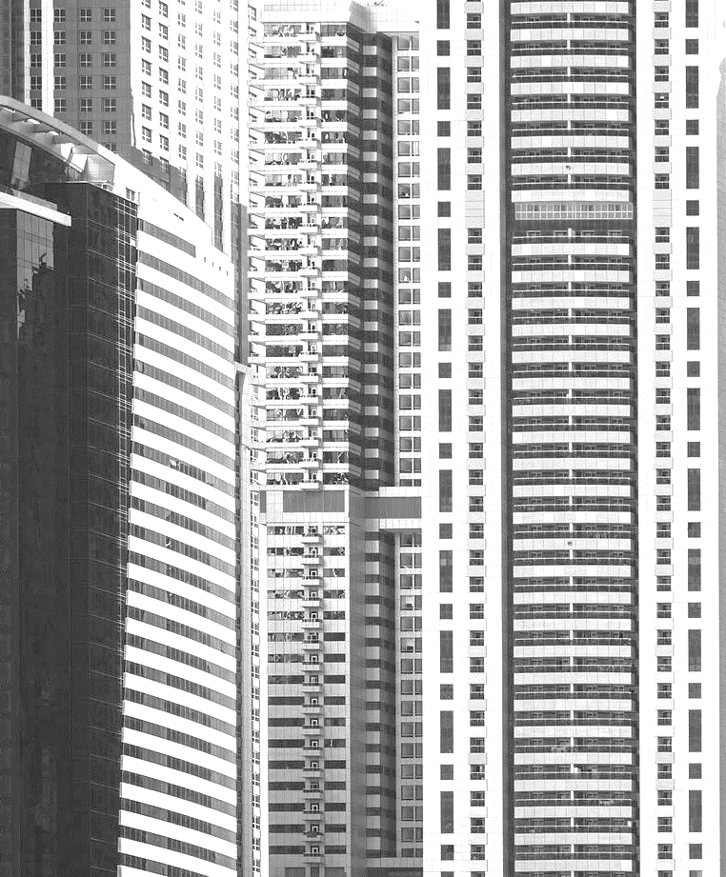
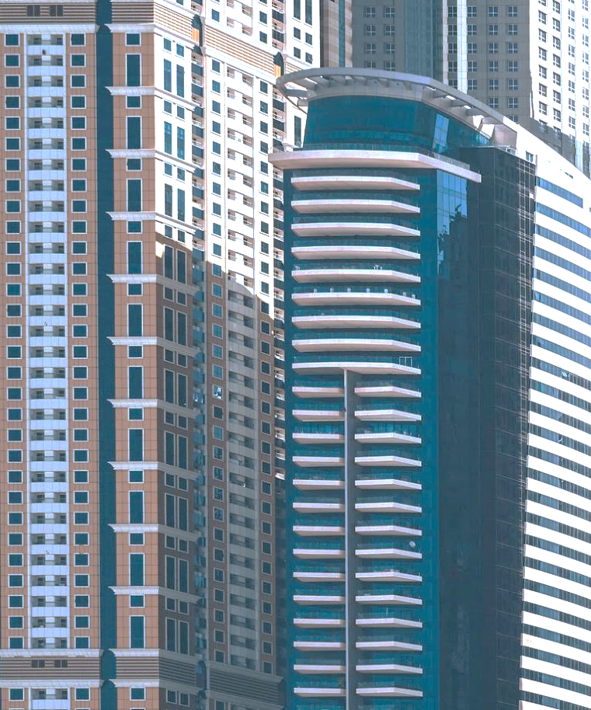
To do:
Modelling a maze mathematically
Constraining the problem
Pivot to the solution
Feasibility and uniqueness
Future research questions

Slide 3
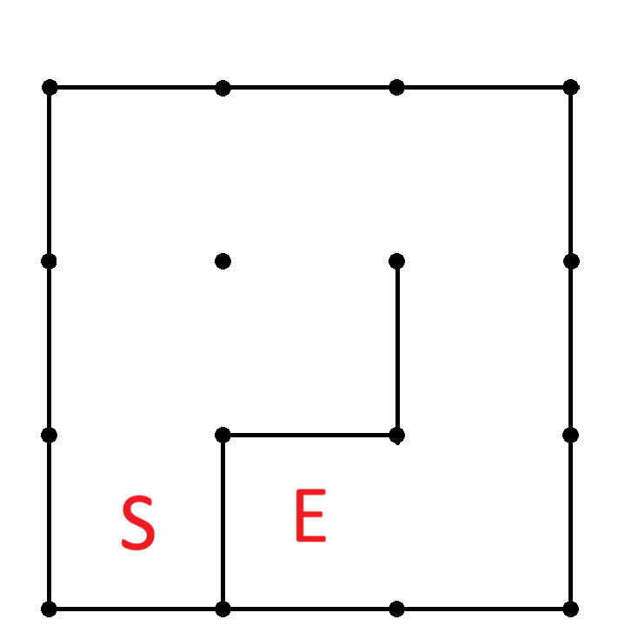

The math of the maze

Slide 4
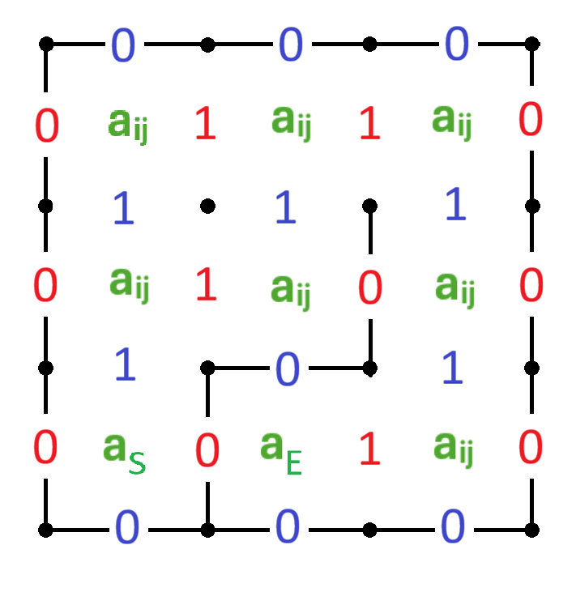
The math of the maze

Slide 5
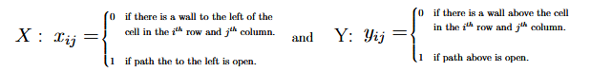
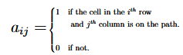
The math of mazes
A :

Slide 6
Constraining the problem
Combining certain values and selection of the shortest path

Slide 7
Known values
Each node (cell) is binary.
0 for not on the path
1 for on the path
The start node is on the path
a_{endRow,endCol} = 1
The end node is on the path
a_{startRow,startCol} = 1

Slide 8
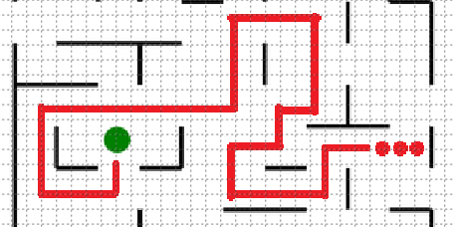
Maze considerations

Slide 9
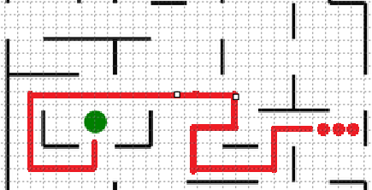
Maze considerations

Slide 10
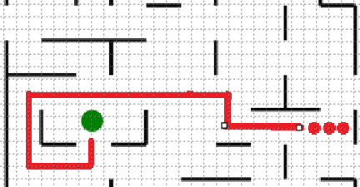
Maze considerations

Slide 11
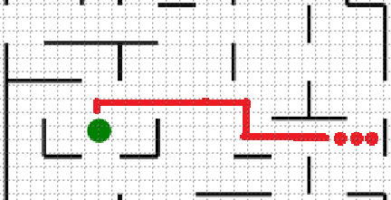
Maze considerations

Slide 12
constraints
Nodes on the Path
Nodes off of the Path
Start and End nodes have exactly one accessible neighbor on the path.
Other nodes have exactly two accessible neighbors on the path.
Nodes far removed from the path have 0 accessible neighbors on the path.
Nodes adjacent to the path may have 0, 1 or 2 neighbors accessible and on the path.

Slide 13
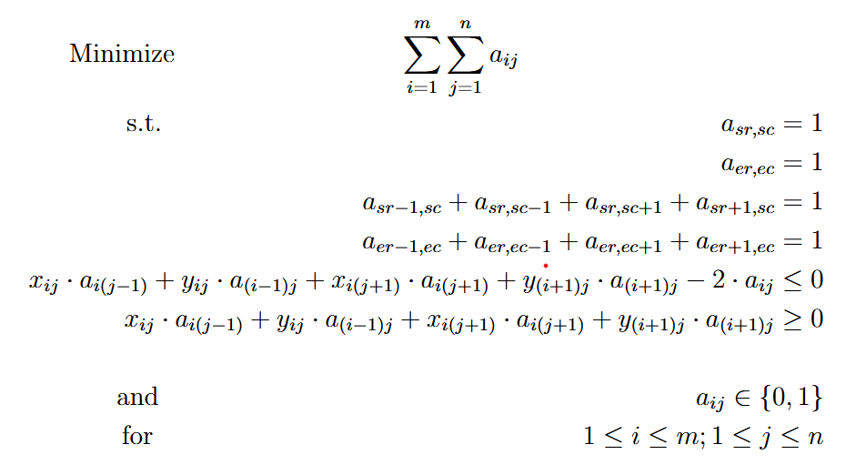
Optimize this:

Slide 14

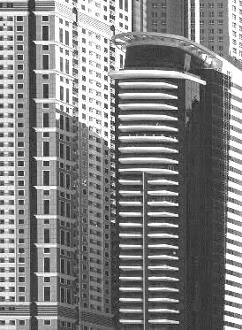
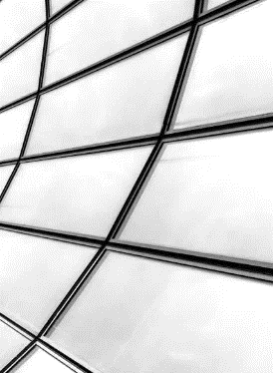
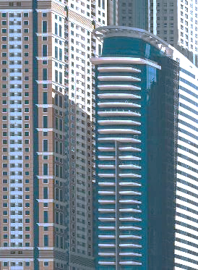
Working the LOP
Phase 0
No free variables
Equality constraints should be brought into the basis​.
Phase 1
Pivot to bring restricted variables into the basis.
This will lead us to a feasible solution
Phase 2
Pivot to remove negative values from the objective row.
This finds the optimal solution within the feasible set found in Phase 1.

Slide 15
Feasibility and uniqueness

Slide 16
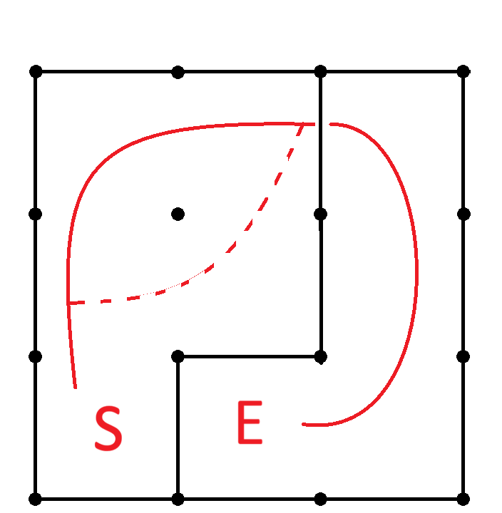
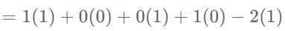
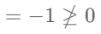
Infeasible results
= INFEASIBLE

Slide 17
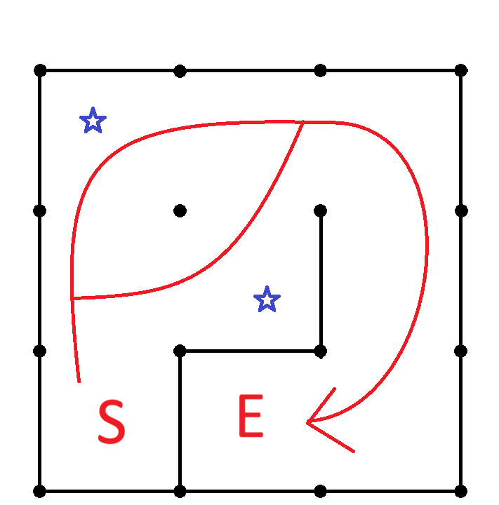
UNIQUENESS
Clearly, our solution is not unique.
But how can we see it through our optimization problem?

Slide 18
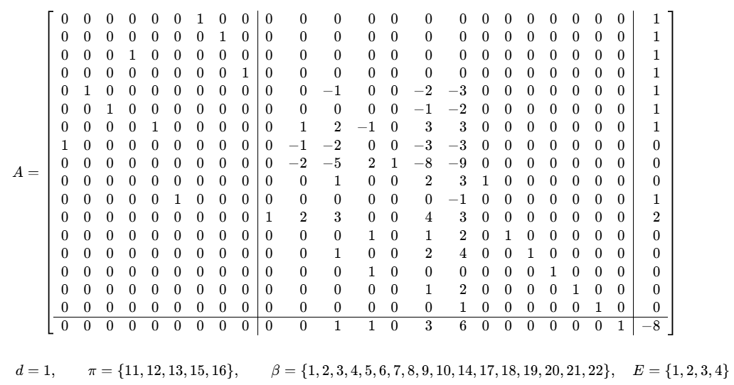
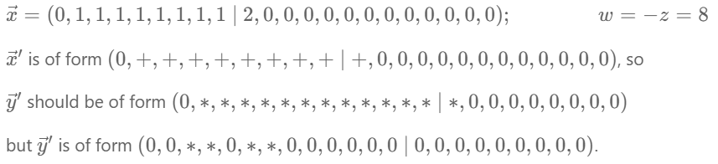
Checking uniqueness through the dual certificate

Slide 19
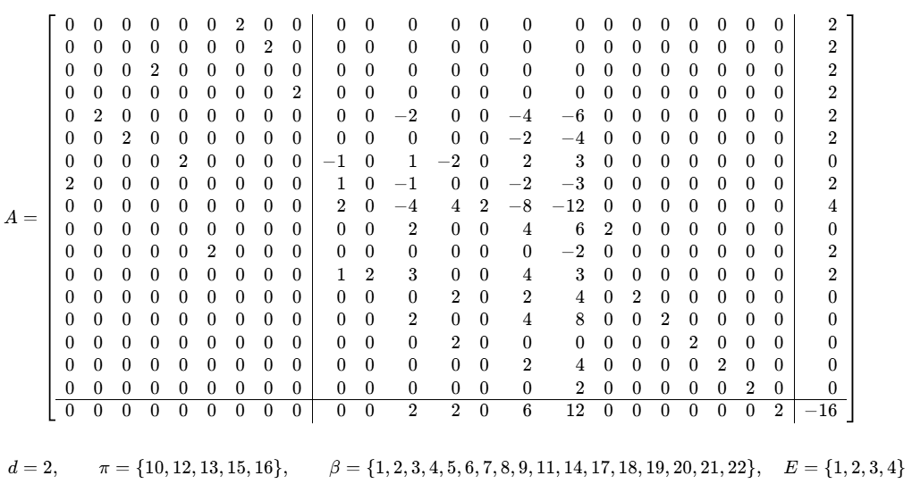
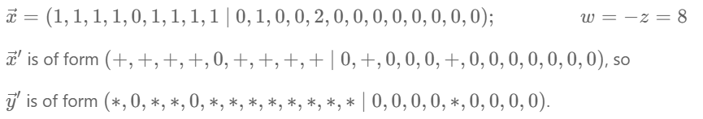
A second solution

Slide 20
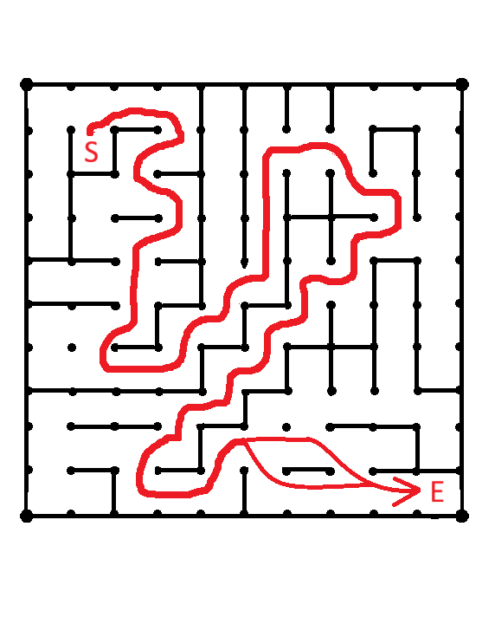
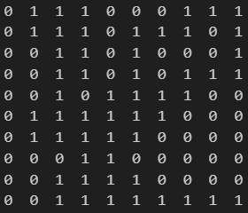
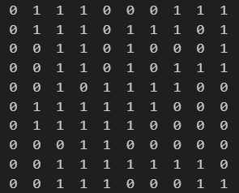
using random perturbation to search for additional solutions

Slide 21
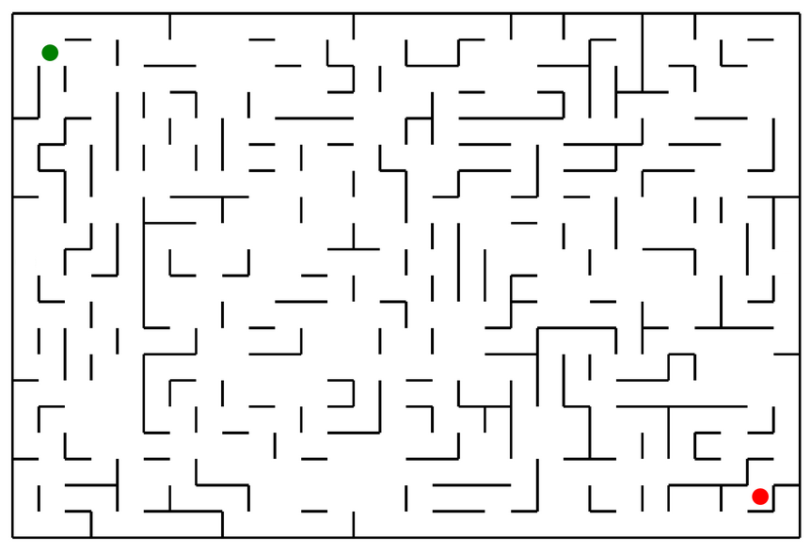
A larger example

Slide 22
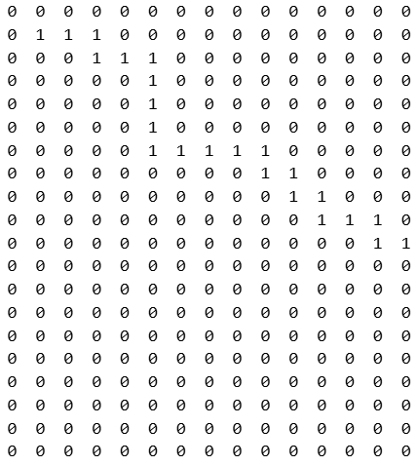
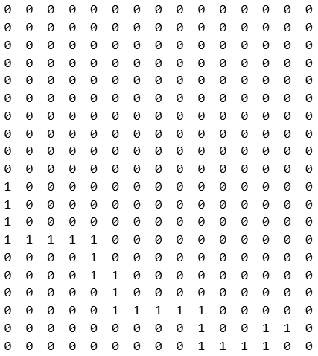
A larger example

Slide 23
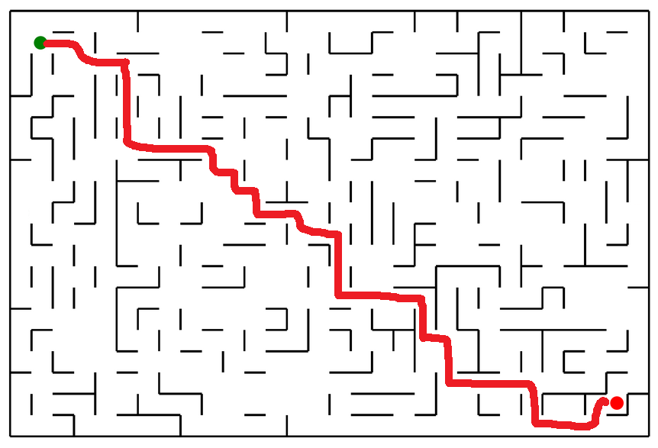
A larger example

Slide 24
But…
We have some problems with the computation of the optimal solution of larger mazes…

Slide 25

Future considerations
Linear Optimization seems a good tool for solving smaller mazes.
For larger mazes, some adjustments need to be made to allow for timely computation of the dual.
Automation of transforming visual mazes into binary matrices can be performed by OpenCV.
Graphics Programming w/ Dr Sethi
Analysis of the computational complexity of solving LOP’s seems necessary to determine if it is an effective tool for solving mazes beyond the miniscule.

Slide 26
THANK YOU
Evan Pritchard
epritch2@fitchburgstate.edu
(570)-977-6169

